Slide 1
IT2757
Server and Services Security Management
- PATCH MANGEMENT AND INCIDENT EVENT MANAGEMENT

Slide 2
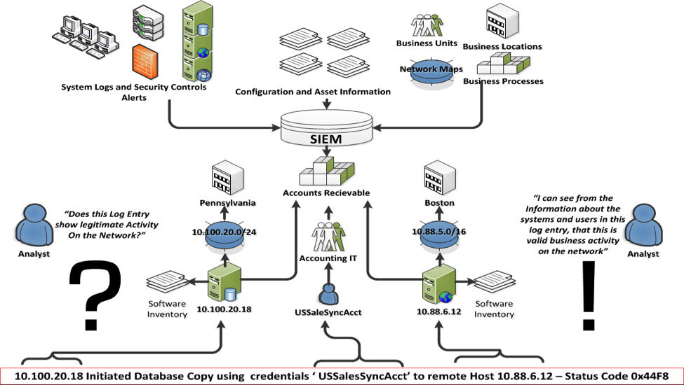
Security Information and Event Management (SIEM)
What is SIEM
  combine security information management (SIM) and security event management (SEM). They provide real-time analysis of security alerts generated by network hardware and applications.

Slide 3
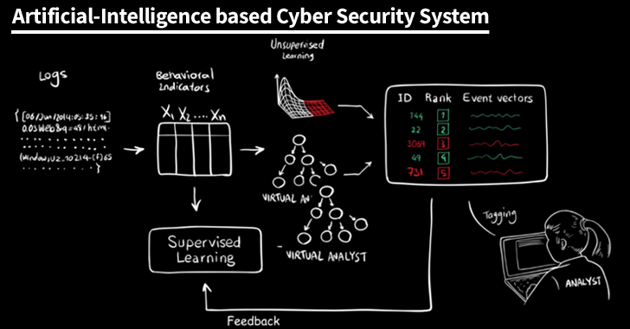
Artificial Intelligence and SIEM

Slide 4
THE END

